Slide 1



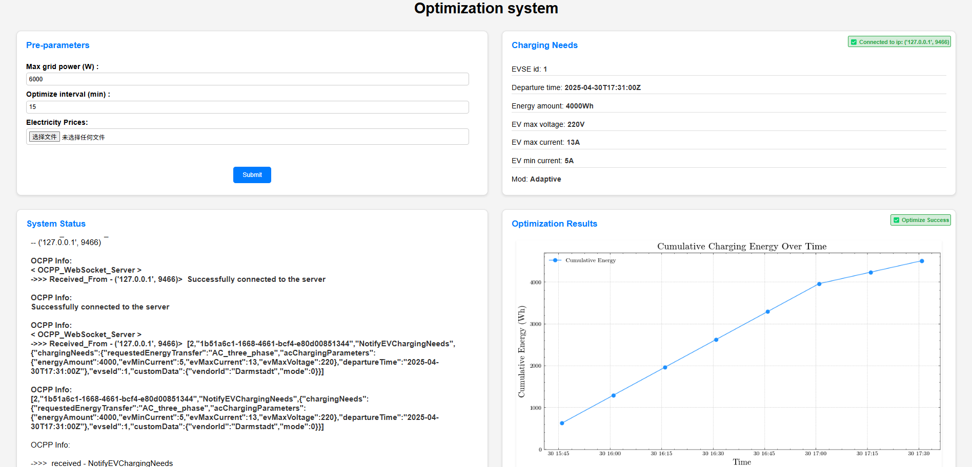
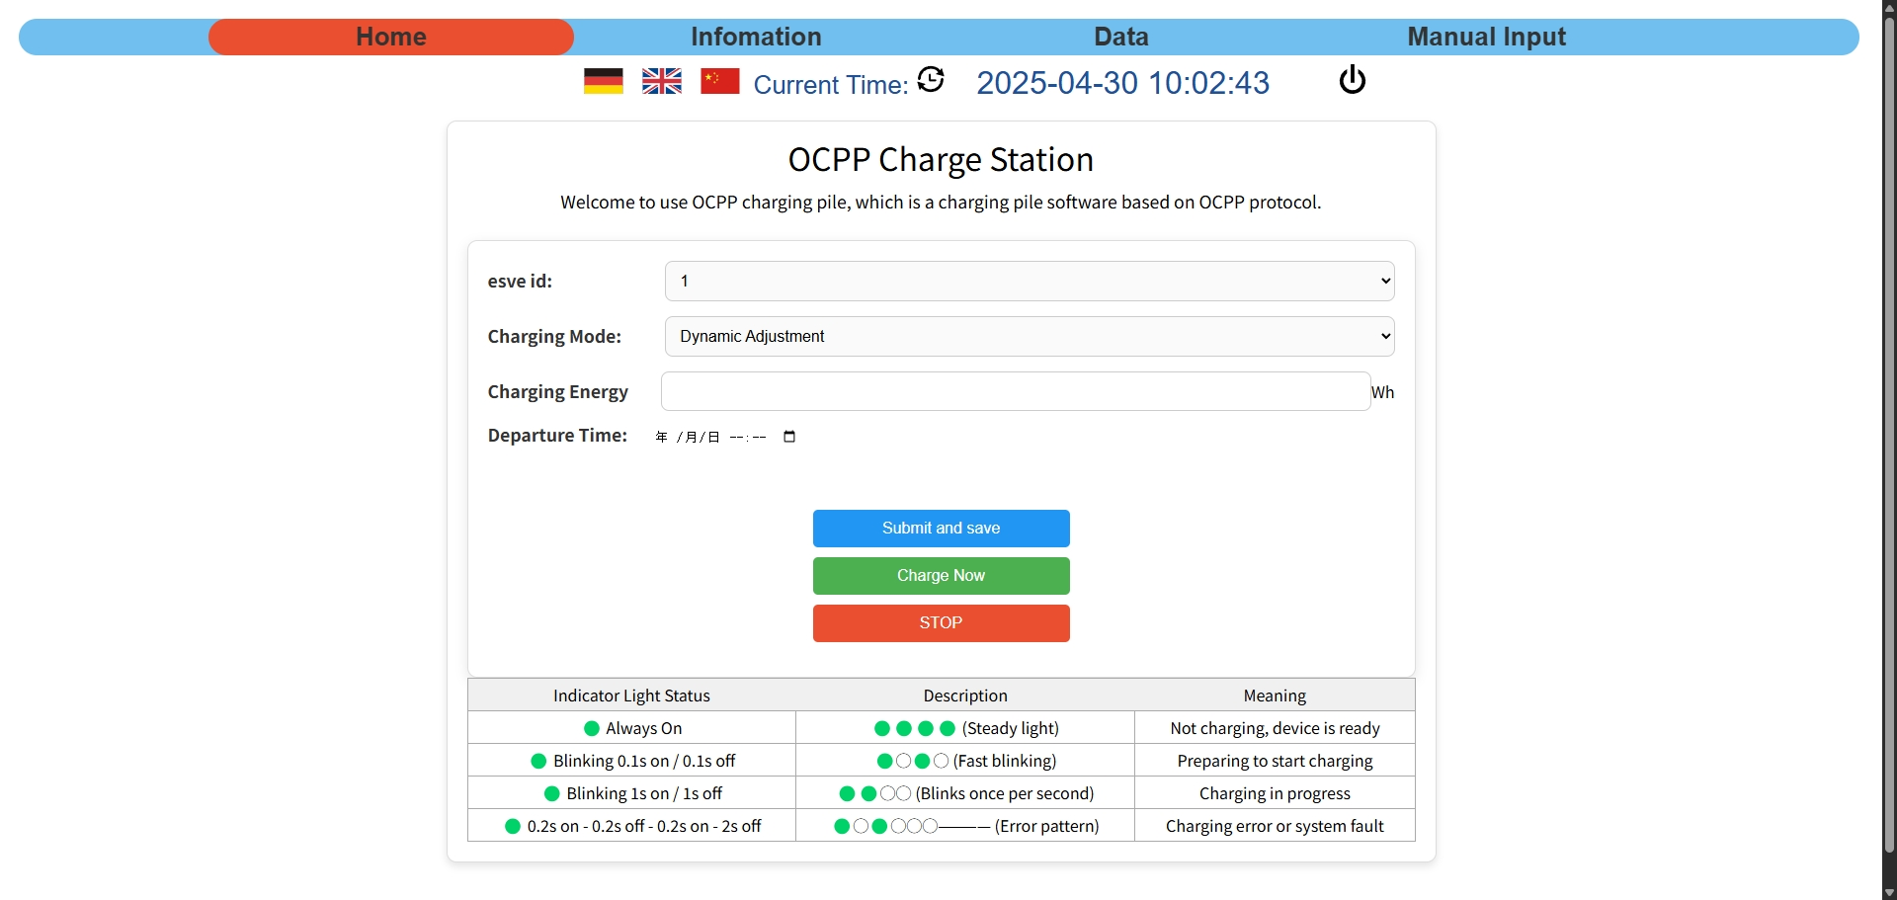
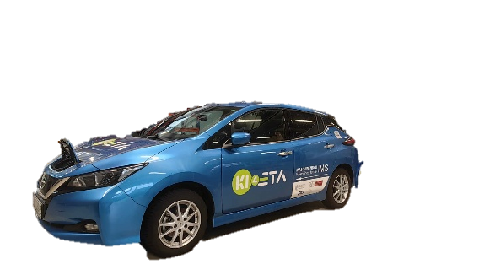
System components
Charging Station
Optimizer
OCPP
HTTP
GUI
PWM
Electric vehicle
Notes:
Our charge system includes an Optimizer, a GUI for visualization, and the Charging Station. They communicate with each other through OCPP, HTTP protocol and PWM signal.
Next my college Yunan will introduce the Hardware part.

Slide 2
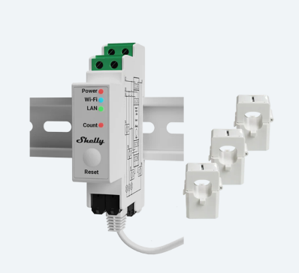
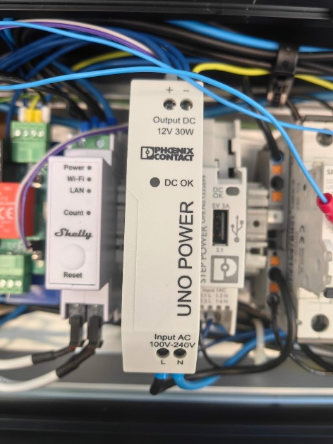
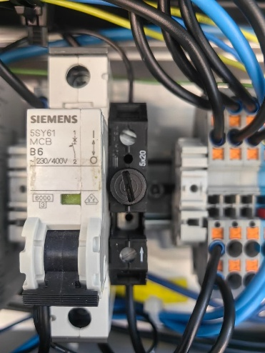
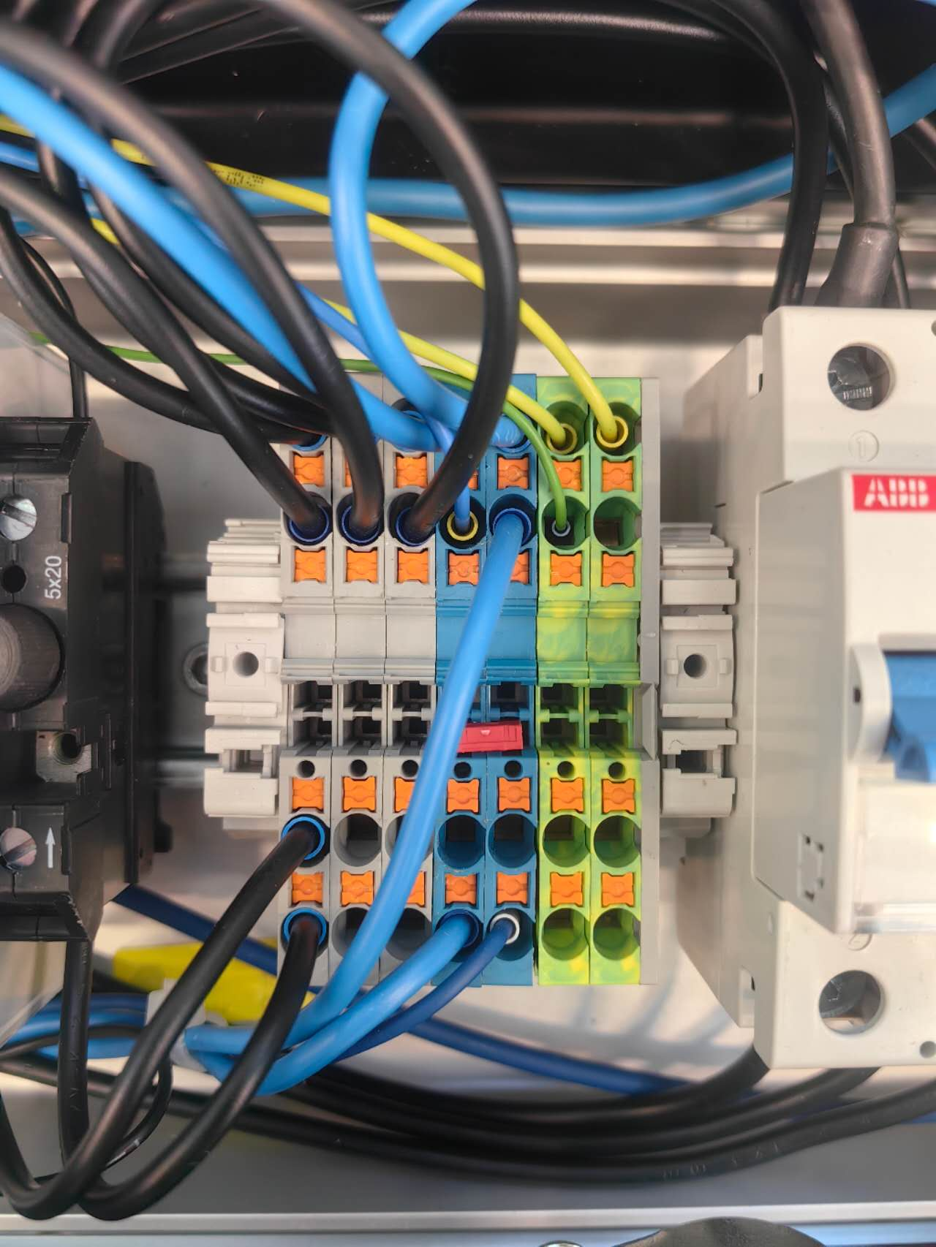
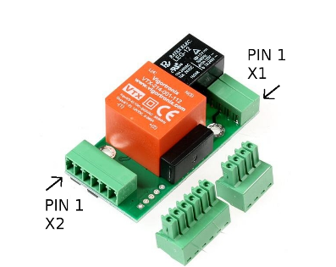
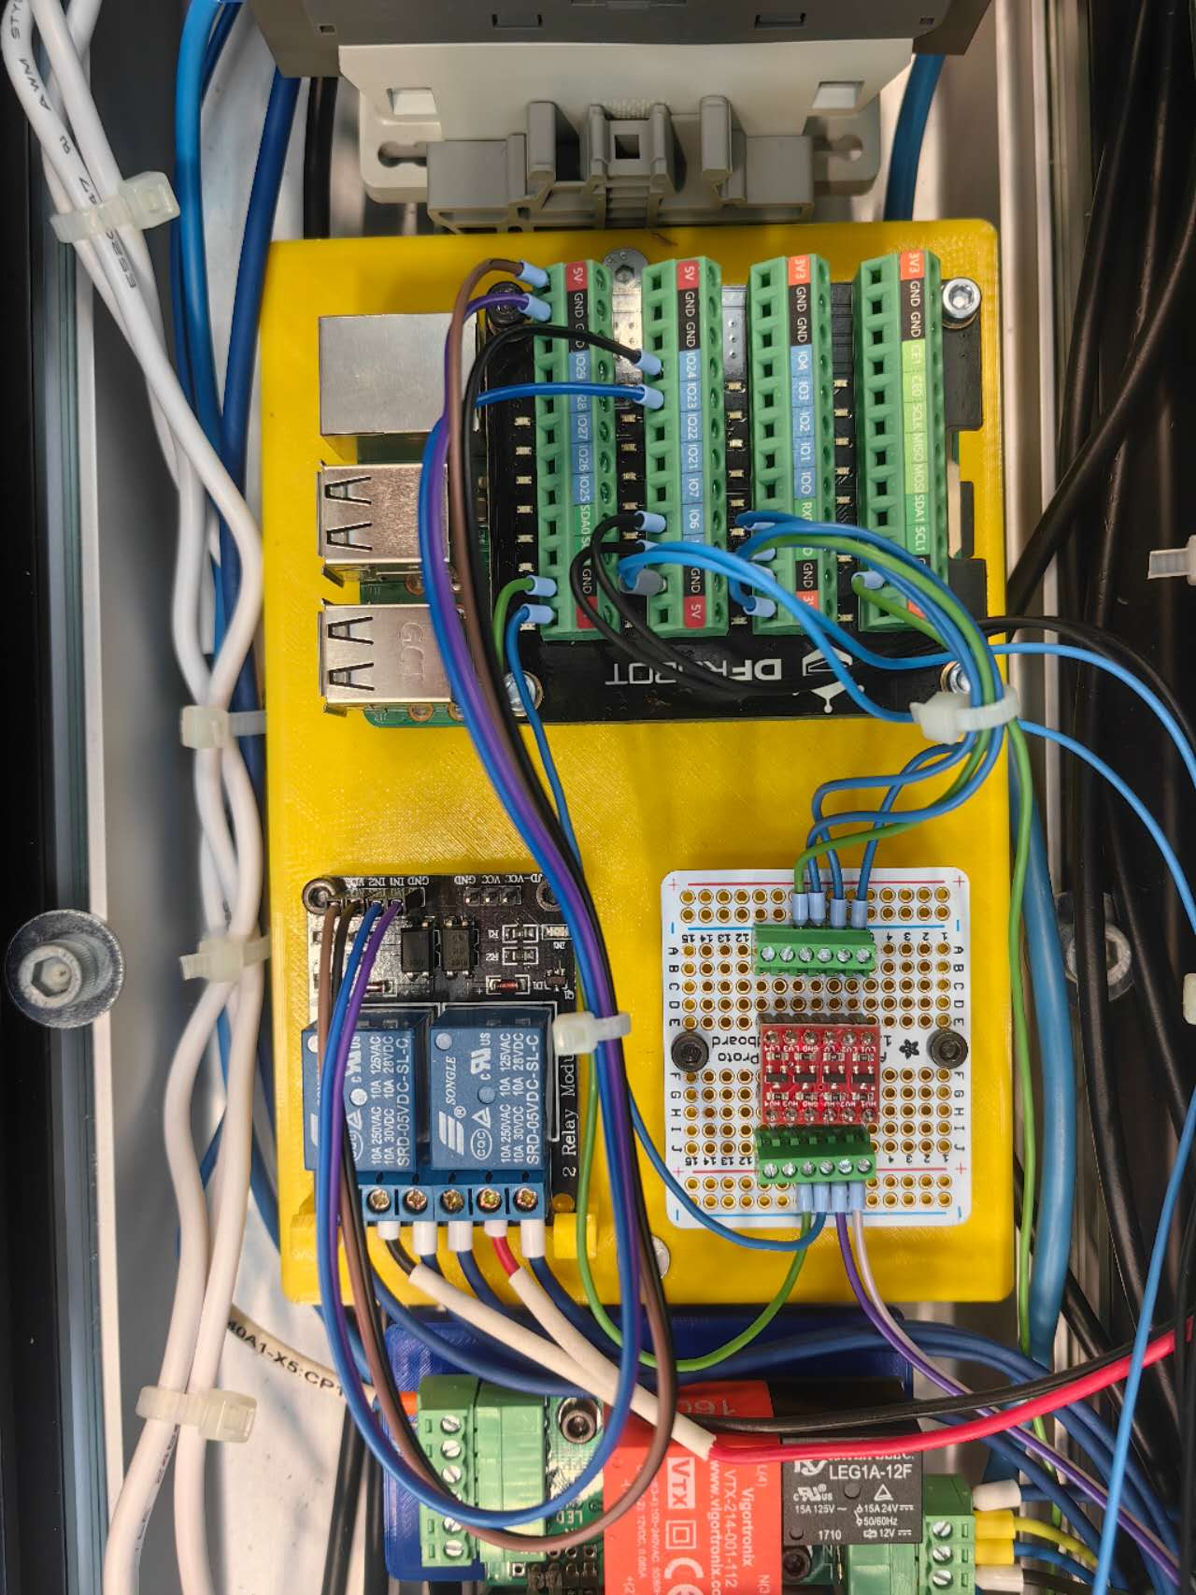
Hardware
Current sensor
Power supply, Circuit breaker, Fuse, Wire connector, etc.
EVSE
Smart charge board
Auxiliaries
Original charge station
Main functional components
Notes:
Our charging station is mainly composed of these parts

Slide 3
Main functional components
Current sensor
from Shelly
Shelly Pro 3EM
3 current clamps measure the 3-phase current: used for Data Visualization.
Record total charged energy: used for the Correction of the charge plan.
EVSE
Electric Vehicle Supply Equipment
Communicate with EV in the form of PWM signal and voltage level, indicating the maximal allowed current and vehicle state.
Controlled by reading/writing the corresponding registers via Modbus communication
Notes:
The main functional components include a shelly sensor. This sensor can measure the current of the 3-phase power with its clamps and record total charged energy.
EVSE stands for Electric Vehicle Supply Equipment. It is mainly used to set the max current and get the vehicle state.

Slide 4

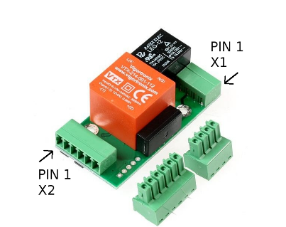
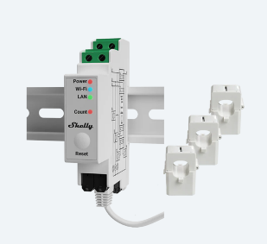
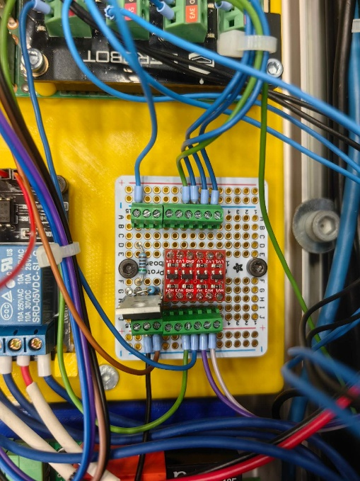
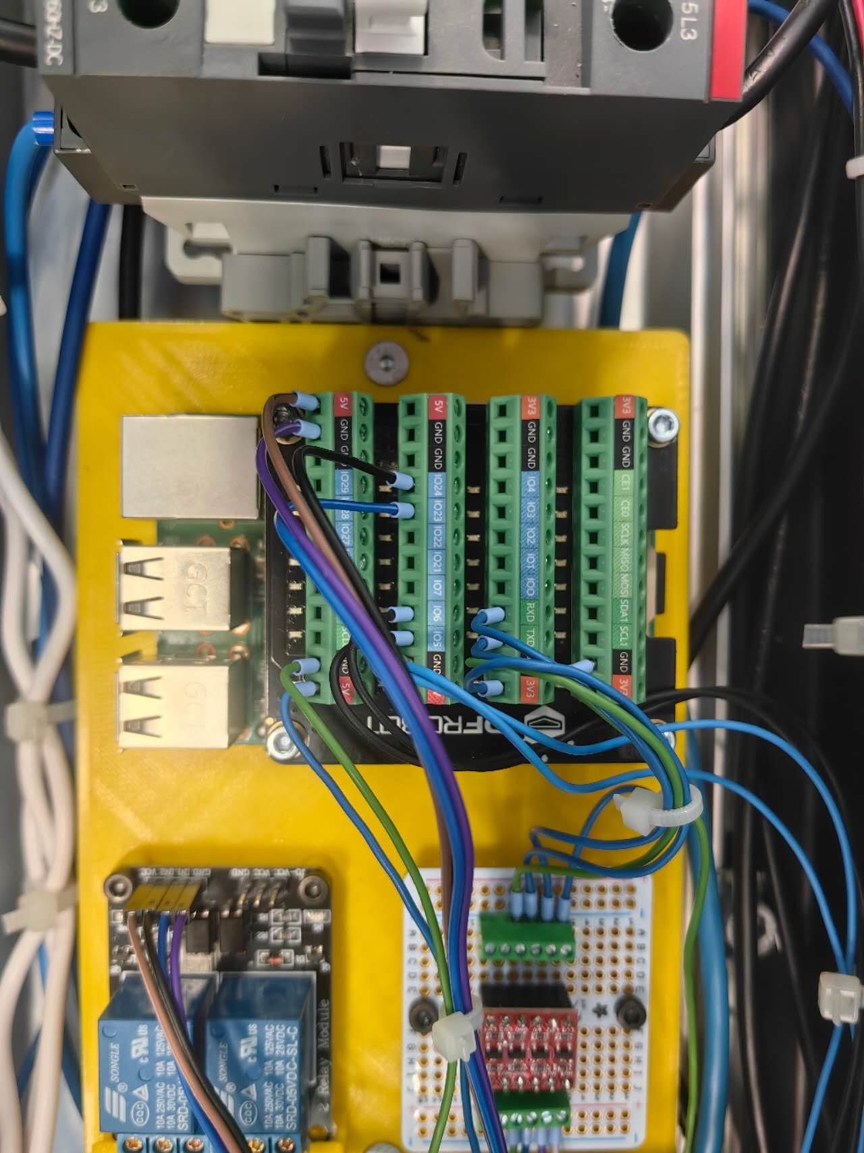

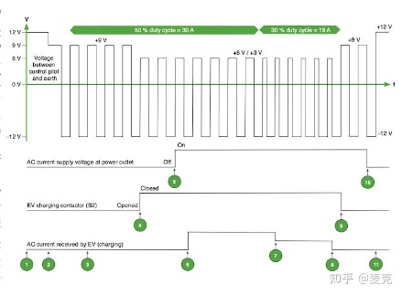

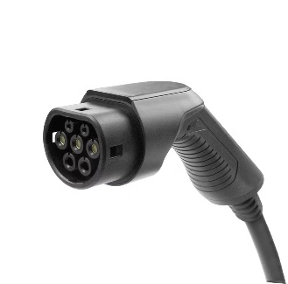
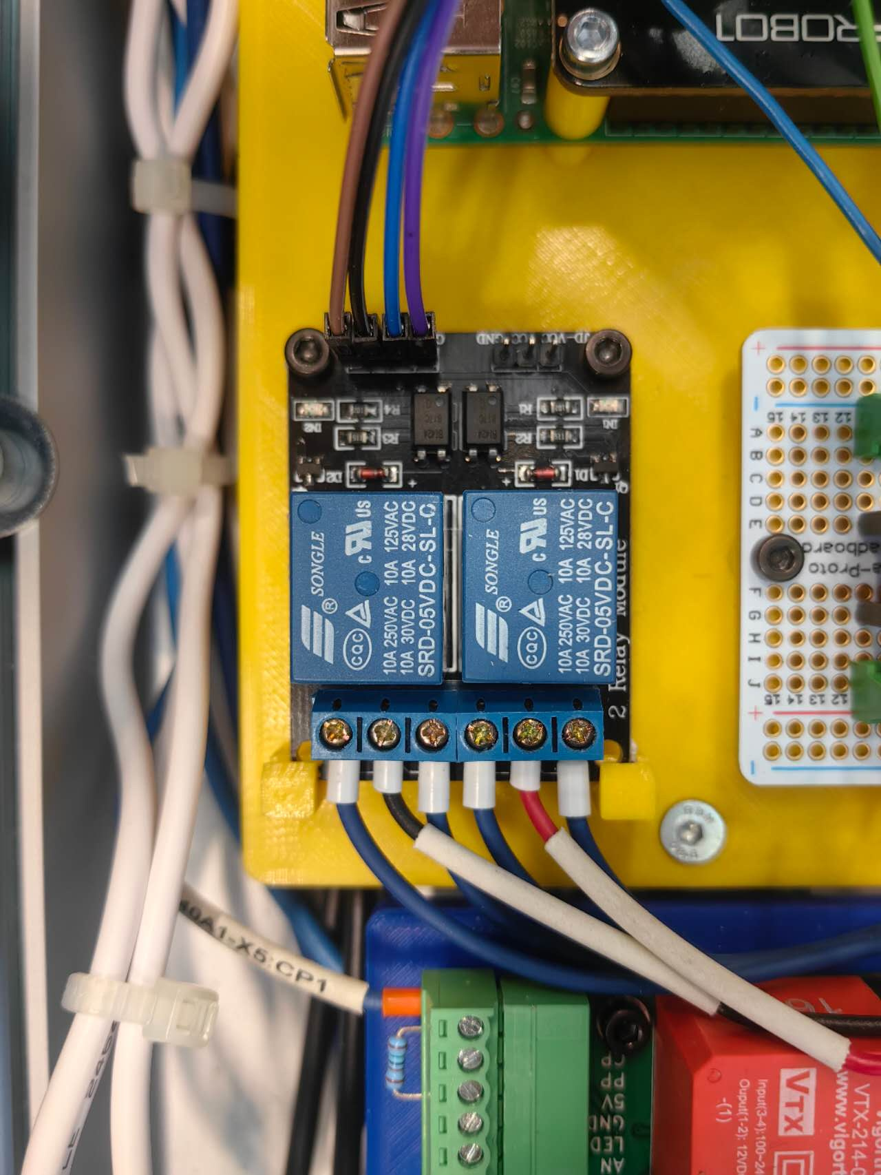
Main functional components
Web port
Level shifter
EVSE
3.5V
5V
TX/RX
RX/TX
Wireless
Serial communication
Shelly
Raspberry Pi
GPIO
LED
PWM signal
Latch motor
Relay
Notes:
The smart charge board is the most important part. It is a 3D-printed board to mount the components on the charging station.
Raspberry Pi is the carrier of the program. It communicates with different components in various ways.
Shelly， the web port, and Raspberry Pi are connected to the same Wifi and transmit information wirelessly.
The Raspberry Pi communicates with EVSE via serial communication. But the working voltage of these two parts is different. So we add a level-shifter in between to convert the voltage. Otherwise the GPIO pins will be damaged.
The EVSE communicates with the EV in form of PWM signal. The duty cycle represents the allowed current, and the voltage level represents different vehicle states.
We also utilized the GPIO pins of Raspberry Pi for the latching og charge plug with motor and relay, or controlling the LED.

Slide 5



Charge modes
Direct charging
Manual schedule
Dynamic adjustment
Start
Stop
Buttons on the charge station or website
Charge according to the uploaded schedule
Start time point, charge power of each time interval
The schedule is generated by the optimizer according to the user’s needs.
Correction of the charging plan periodically
Notes:
We have designed 3 charge modes.
Direct charging can literally only control the start and stop of charging, by pressing the buttons on the charge station or via the website. Then the charge station will charge at the maximum allowed current.
The Manual schedule mode is mainly used for debugging. The charging station will charge according to an uploaded schedule. In this schedule we define the charge start time point and charge power of each time interval.
The dynamic adjustment mode is the main target of our project. It realizes the smart charging. The schedule is generated by the optimizer according to the user’s needs such as “lowest electric price” or “balanced price and speed”. The charging plan will be corrected periodically to compensate for the deviation in the charging process, based on the data collected from the shelly sensor.

Slide 6
Detailed charging steps
Plug in the charge plug
Select the charge mode and start
Before charging
In charging
Charging ends
EVSE:
EV is present
Check:
Vehicle,
EVSE,
Shelly, applicable plan
Latch plug
The optimizer generates the charge schedule
Max. current to EVSE
Correction
Polling-EVSE, Shelly
Unlatch
Clear data
If not
ERROR
Hardware failure
Notes:
The charging stations will perform different actions at different stages of charging.
When the user inserts the charge plug selects the charge mode and presses the start button. The system will check if all the components are working properly, and also check if the plan is applicable, for example, the user wants to fully charge the car in 5 minutes. It will be rejected because the required power is clearly much higher than the power limit.
Anything abnormality in this process will lead to an error, the charging will not start.
If everything is OK, the station will latch the plug, the optimizer will generate the charge schedule.
In the charging process, the output power is controlled by changing the maximum current value in the EVSE register.
The system will periodically correct the plan, and get data from the EVSE and the Shelly sensor via polling. If any hardware failure occurs in this process, it will also raise an error and immediately terminate the charging.
After the charging is finished, the charge station will unlatch the charge plug and clear the data stored in Shelly.

Slide 7
Trim of plan – Influence of delay
Power[kW]
Power limit (6kW for example)
6
4kW
2kW
System response delay
Network delay
5
4
2kW
Legend
3
Charge power of charge unit 1 (EV 1)
2
Charge power of charge unit 1 (EV 1)
1kW
2kW
1
1kW
Charge power of charge unit 1 (EV 1)
0
0.5
1
1.5
2
Time[h]
0
Notes:
In our project, we have considered a lot about the influence of delays.
For example, according to the original plan the 3 charge units should charge without violating the limit.

Slide 8
Trim of plan – Influence of delay
Exceed the limit
Power[kW]
Power limit (6kW for example)
6
4kW
4kW
2kW
System response delay
Network delay
5
delay
4
2kW
Legend
3
Charge power of charge unit 1 (EV 1)
2
Charge power of charge unit 1 (EV 1)
1kW
2kW
1
1kW
Charge power of charge unit 1 (EV 1)
0
0.5
1
1.5
2
Time[h]
0
Notes:
However, due to the System response delay and Network delay, the charge schedule of unit 1 arrived later.
Consequently, the total power exceeds the limit for a certain duration. This may cause equipment overload.

Slide 9

Trim of plan
Arrive of New schedule/
Schedule update
New schedule start time is in future
Now
New schedule
Old schedule
Time
Notes:
To solve this problem, and also to handle the update of new schedule, the system will not directly execute the new schedule when it arrives.
If the new schedule starts in the future, the system will wait or continue with the old schedule.

Slide 10
Trim of plan
Arrive of New schedule/
Schedule update
Now
Old schedule
New schedule after truncation
Time
New schedule
New schedule start time already passed
Notes:
If the new schedule start time point is already passed, the system will cut off the expired parts of the schedule, and continue with the rest.

Slide 11
Trim of plan – Influence of delay
4kW
4kW
2kW
Power[kW]
Power limit (6kW for example)
6
5
4
delay
2kW
Legend
3
Charge power of charge unit 1 (EV 1)
2
Charge power of charge unit 1 (EV 1)
1kW
2kW
1
1kW
Charge power of charge unit 1 (EV 1)
0
0.5
1
1.5
2
Time[h]
0
Notes:
In this way, this risk is avoided and the deviation will be compensated by the following corrected schedules.
Then my college Zeng Can will introduce the Optimizer part.

Slide 12
VIELEN DANK!

